Slide 1

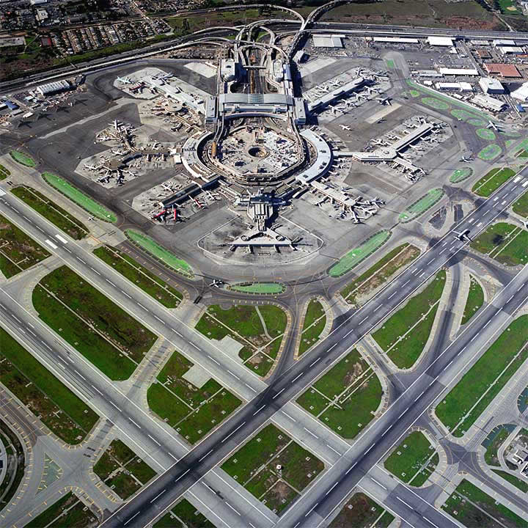

Sustainable Airport Design & Evaluation
Advisor:
Jasenka Rakas, Ph.D.
Team:
Derek Doan
Connie Lau
Elmira Manafiafkham
Amir Orangi
Adrian Quiroz
Lenard Tran
Alexander Winn
Vicky Woen
Ollie Zhou
http://coastalairsystems.webs.com/ourcentralhub.htm

Slide 2

Sustainable Airport Design & Evaluation
Purpose:
To provide and analyze examples of expanding and remodeling new and established airports that will further promote sustainability.

Slide 3
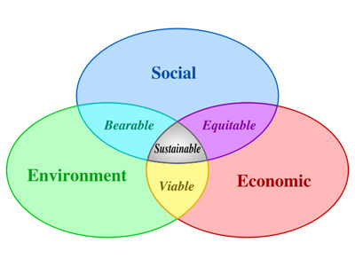
Sustainable Airport Design & Evaluation
Sustainability
http://www.sustainability.umd.edu/content/about/what_is_sustainability.php

Slide 4
Sustainable Airport Design & Evaluation
Impact Matrix
Functional Areas | GWP | Virgin Materials | Noise | Air Quality | Water Impact | Wildlife | $
Airfield | ✓ | ✓ | ✓ | ✓ | ✓ | ✓ | ✓
Ground Support Equipment | ✓ | ✓ |  | ✓ | ✓ |  | ✓
Terminal Facilities | ✓ | ✓ | ✓ | ✓ |  | ✓ | ✓

Slide 5
Airfield: Pavement Materials
Outline
Pavement design
Material Selection Key role
Engineering calculation
Sustainability evaluation
Indicators:
Greenhouse gas emission
Water withdrawal
RCRA( Haz waste)
Global Warming

Slide 6
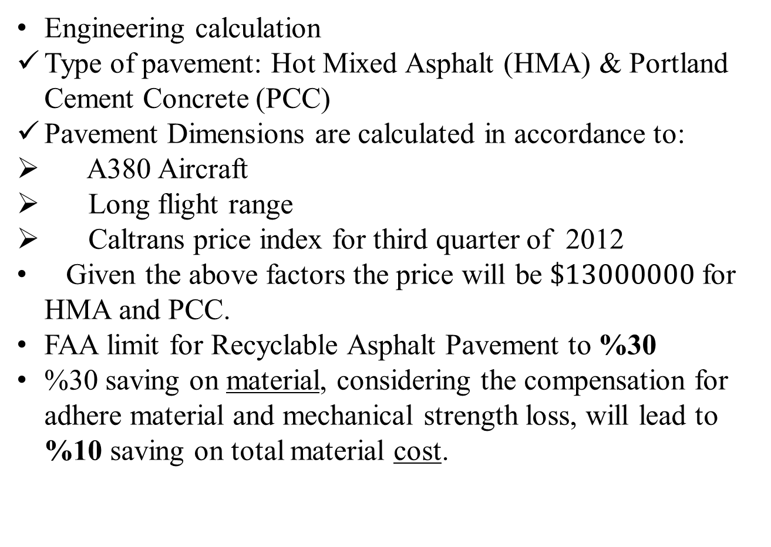
Airfield: Pavement Materials
Engineering calculation
Type of pavement: Hot Mixed Asphalt (HMA) & Portland Cement Concrete (PCC)
Pavement Dimensions are calculated in accordance to:
A380 Aircraft
Long flight range
Caltrans price index for third quarter of 2012
Given the above factors the price will be $\$13000000$ for HMA and PCC.
FAA limit for Recyclable Asphalt Pavement to %30
%30 saving on material, considering the compensation for adhere material and mechanical strength loss, will lead to %10 saving on total material cost.

Slide 7

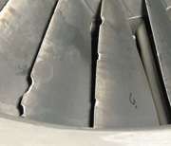
Airfield: Pavement Materials

Slide 8
Airfield: Pavement Materials
Sustainability Evaluation
EIOLCA tool available at www.eiolca.net
Input data will be based on material cost
Compare between using %100 of virgin material and RAP

Slide 9
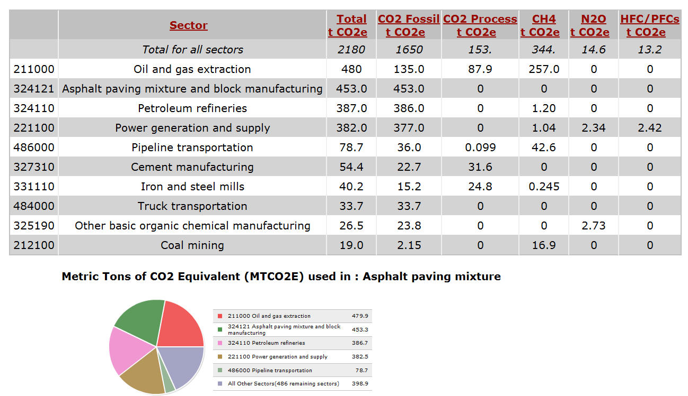
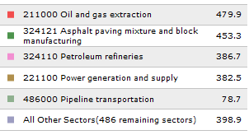
Airfield: Pavement Materials
Greenhouse gas

Slide 10
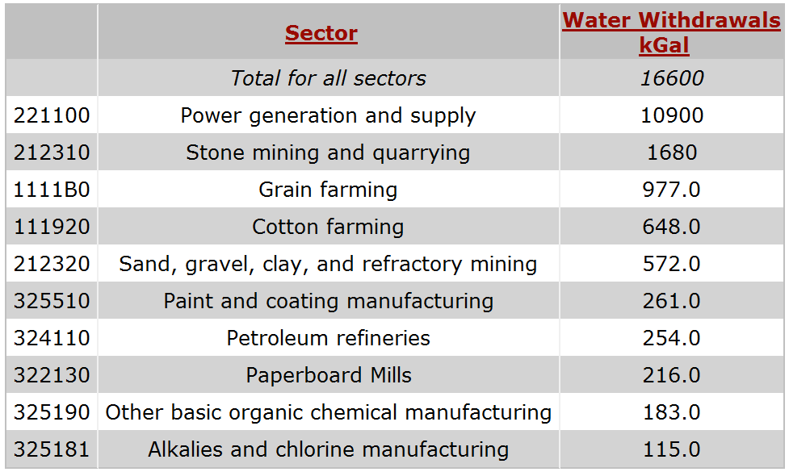
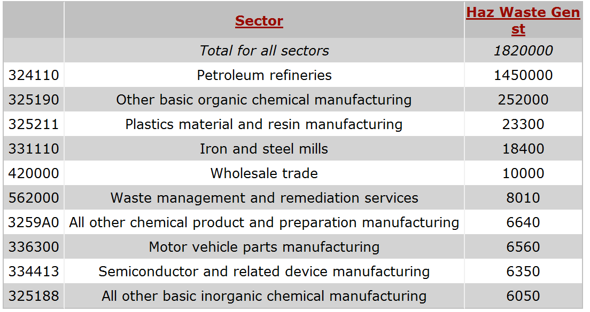
Airfield: Pavement Materials
Water withdrawal RCRA waste

Slide 11

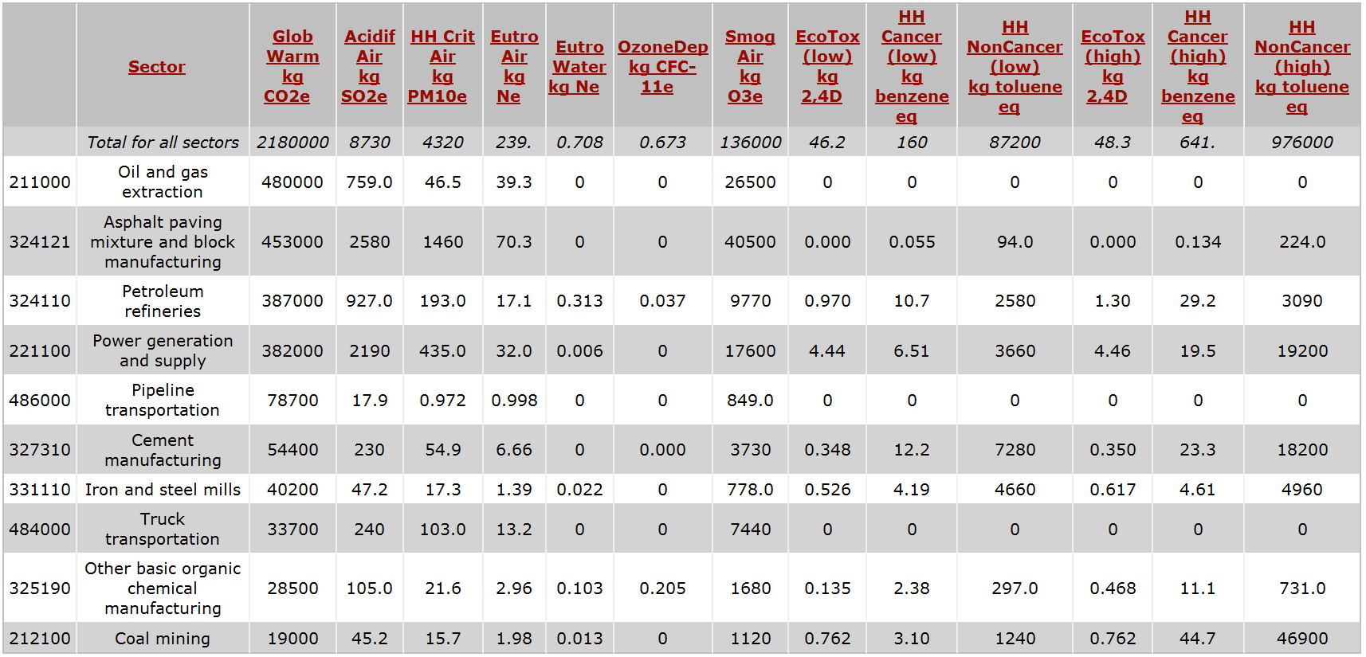
Airfield: Pavement Materials
Global warming
Other indicators
Human Health (Cancer)
Wildlife
Energy

Slide 12
Airfield: Pavement Materials
Discussion & Recommendations
Nationwide
Using saved budget in other sectors
Using more RAP -----Airport in Italy(85%)
Challenge FAA limits------Mechanical test
(Research project)
Recyclable material from other industries
Environmental footprint, Performance, Cost effectiveness:
Airport pavement management system

Slide 13
Sustainable Airport Design & Evaluation
Impact Matrix
Functional Areas | GWP | Virgin Materials | Noise | Air Quality | Water Impact | Wildlife | $
Airfield: Pavement Materials | ✓ | ✓ |  | ✓ | ✓ | ✓ | ✓

Slide 14
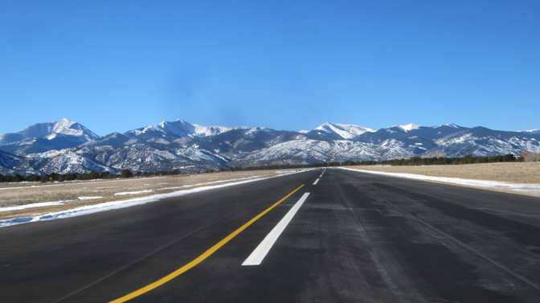
Airfield: Pavement Preservation
http://www.jviation.com/services/airport-engineering/airfield-pavement-rehabilitationharriet-alexander-field/

Slide 15
Airfield: Pavement Preservation
Sustainable Maintenance: An Emerging Necessity
“A sustainable transportation system is safe, healthy, affordable, and renewable, operates fairly, and limits emissions and the use of new and nonrenewable resources.”- Federal Highway Administration
However, considering environmental impact beyond construction is an emerging research field.
Sustainable pavement preservation practices, exist but not a method to quantify environmental impacts.

Slide 16
Airfield: Pavement Preservation
Current State of Sustainable Evaluation
 | Does your agency use environmental performance to select maintenance and/or preservation program practices? |  | Do you have an agency-wide “sustainability” program that includes pavement maintenance activities? |  | Does your agency have sustainable maintenance speciﬁcations?
 | NO | YES | NO | YES | NO | YES
Canada | 7 | 0 | 5 | 2 | 7 | 0
U.S | 40 | 2 | 38 | 4 | 41 | 1
Total | 47 | 2 | 43 | 6 | 48 | 1
Percentage | 96% | 4% | 88% | 12% | 98% | 2%
Source: http://onlinepubs.trb.org/onlinepubs/nchrp/nchrp_rrd_365.pdf

Slide 17
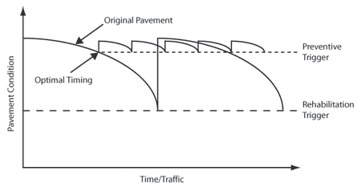
Airfield: Pavement Preservation
Benefits of Sustainable Pavement Preservation Practices
Pavement Preservation promotes energy and resource conservation, also reduces greenhouse gas emissions.
Preventative Pavement Maintenance extends life cycle, postpones pavement rehabilitation.
Source: http://www.fhwa.dot.gov/pavement/preservation/ppc0621.cfm

Slide 18
Airfield: Pavement Preservation
Airfield Pavement Management System (APMS)
Source: http://onlinepubs.trb.org/onlinepubs/acrp/acrp_syn_022.pdf
Survey: Usage of APMS
Grade | Excellent and Essential | Benefits Outweigh Costs | Accepted and Used | Functional but can be Improved | Useless
Percentage | 30% | 9% | 24% | 27% | 0%
* 84 % of APMS using airports reported improvement in pavement condition.
Systems Level Management of Pavement Preservation
Selection of Alternatives based on LCA , B/C, and Prioritizing
Improves Sustainability in areas of Operational Efficiency and Economic Sustainability.

Slide 19

Airfield: Pavement Preservation
The Missing Consideration in Maintenance Preservation Alternatives
Facility Type Requirements
Pavement Surface Quality
Existent Pavement Condition
Construction History
Pavement Dimensions
Demolition Needs
Structural Pavement Strength
Anticipated Traffic Loads
Environmental Exposure
Life Cycle Costs
Benefits
Construction Time Available
Availability of Funds
Facility Downtime
Operational Constraints
Source: http://onlinepubs.trb.org/onlinepubs/acrp/acrp_syn_022.pdf

Slide 20
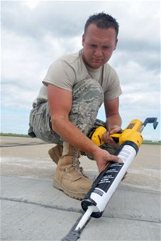
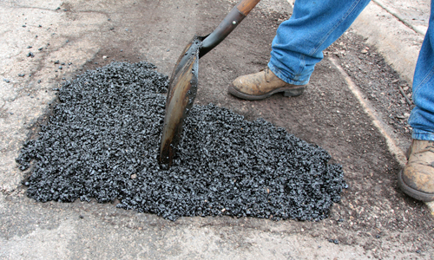
Airfield: Pavement Preservation
Incorporation of Environmental Impact
“..An assessment tool to properly quantify environmental sustainability in the pavement preservation and maintenance context is both
missing and required.”- National Cooperative Highway Research Program
Source: http://www.jble.af.mil/photos/mediagallery.asp?galleryID=1263&page=33
Challenge: Creating quantities for environmental sustainability with a lack of research on the environmental impact of pavement preservation strategies.

Slide 21
Airfield: Pavement Preservation
Implementation Strategy
Creating organizational breakdown of Airfield Pavement Preservation operations to offer level of planning flexibility.
Identifying areas of Environmental Impact relevant to Pavement Preservation Practices.
With a framework of operations breakdown and areas of impact, provide both qualitative and quantitative assessments of environmental impact.
Provide flexibility for general use that considers lack of research and the uniqueness of every airport.

Slide 22
Airfield: Pavement Preservation
Functional and Impact Areas
Functional Areas
Preventative Maintenance
Routine Maintenance
Pavement Rehabilitation
Impact Areas
Resource Conservation
Noise
Green House Gas Emissions
Water Quality
Energy

Slide 23
Airfield: Pavement Preservation
Matrix of Impact
 | Resource Conservation | Noise | G.G.E | Water Quality | Energy
Preventative Maint. | √ | √ | √ | √ | √
Routine Maint. | √ | √ | √ | √ | √
Pavement Rehab. | √ | √ | √ | √ | √

Slide 24
Airfield: Pavement Preservation
Level of Planning Breakdown
Functional Area
Pavement Rehabilitation
Impact Clusters
Materials
Transportation
Construction
Alternatives
Municipal Water
Recycled Run-off
Water
Identify Areas of Impact
Resource Conservation

Slide 25
Airfield: Pavement Preservation
Environmental Impact Metrics: Quantitative
Functional Area: Routine Maintenance
Impact Cluster | Impact Priority Factor | Impact Units | Impact Areas
Transportation | 0 < P < 1 .63 .37 | Lbs. of CO₂ Lbs. of Gasoline | G.G.E Energy
Alternative A | .63 | 1.56 Lbs. of CO₂ | G.G.E
Alternative A | .37 | 201.6 Lbs. of Gasoline | Energy
Alternative B | .63 | 1.43 Lbs. of CO₂ | G.G.E
Alternative B | .37 | 156.3 Lbs. of Gasoline | Energy

Slide 26
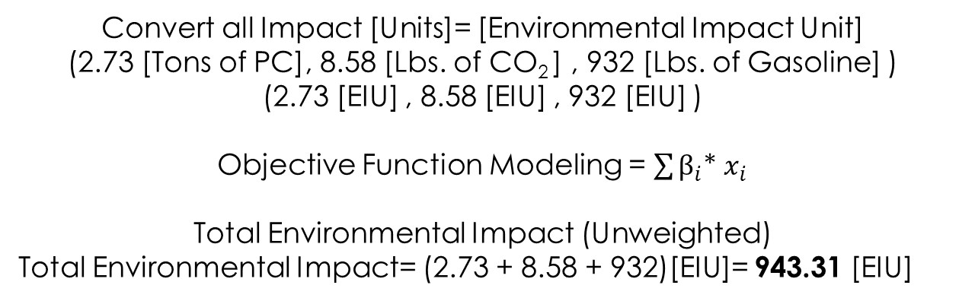
Airfield: Pavement Preservation
Environmental Impact Evaluation : Quantitative
Alternative | Impact Categories
C | Resource Cons. | G.G Emissions | Energy
Impact Quantities | 2.73 Tons of PC | 8.58 Lbs. of CO₂ | 932 Lbs. of Gasoline
Priority Factor | .35 | .22 | .43
Convert all Impact [Units]= [Environmental Impact Unit]
(2.73 [Tons of PC], 8.58 [Lbs. of CO₂ ] , 932 [Lbs. of Gasoline] )
(2.73 [EIU] , 8.58 [EIU] , 932 [EIU] )
Objective Function Modeling = $\sum{β_{i}}$* $x_{i}$
Total Environmental Impact (Unweighted)
Total Environmental Impact= (2.73 + 8.58 + 932)[EIU]= 943.31 [EIU]

Slide 27
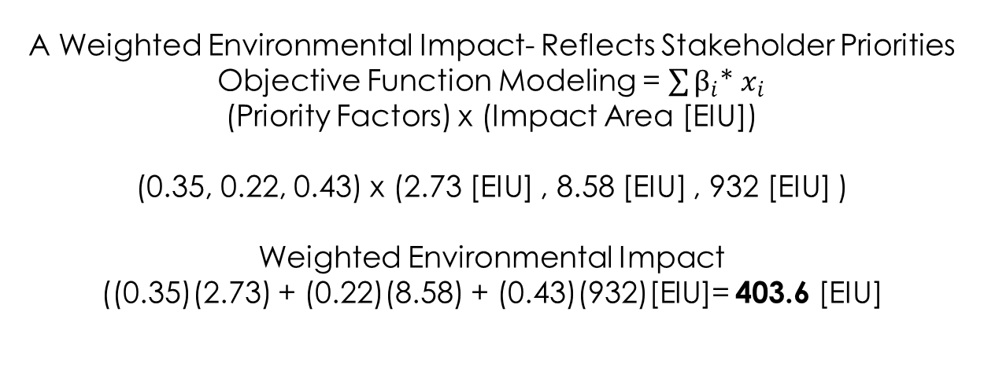
Airfield: Pavement Preservation
Environmental Impact Evaluation : Quantitative
A Weighted Environmental Impact- Reflects Stakeholder Priorities
Objective Function Modeling = $\sum{β_{i}}$* $x_{i}$
(Priority Factors) x (Impact Area [EIU])
(0.35, 0.22, 0.43) x (2.73 [EIU] , 8.58 [EIU] , 932 [EIU] )
Weighted Environmental Impact
((0.35)(2.73) + (0.22)(8.58) + (0.43)(932)[EIU]= 403.6 [EIU]
Other Useful Metrics for Comparison
E.I Annuity – [EIU] / [Life Cycle Extension Years]
(E.I)/Area- [EIU]/[Area of Pavement Enhanced]
Economic Sensitivity – [EIU]/[$ Spent]

Slide 28
Airfield: Pavement Preservation
Environmental Impact Metrics: Qualitative
Alternative | Impact Categories
D | Resource Conservation | Noise | G.G.E | Water Quality | Energy
Score | 3 | 1 | 2 | 0 | 4
Priority Factor | .3 | .01 | .19 | .1 | .4
Scoring based on qualitative assessment of E.I
Score=0, No Environmental Impact
Score=5, Severe Environmental Impact
Priority Factor implemented the same way as a weighting system.

Slide 29
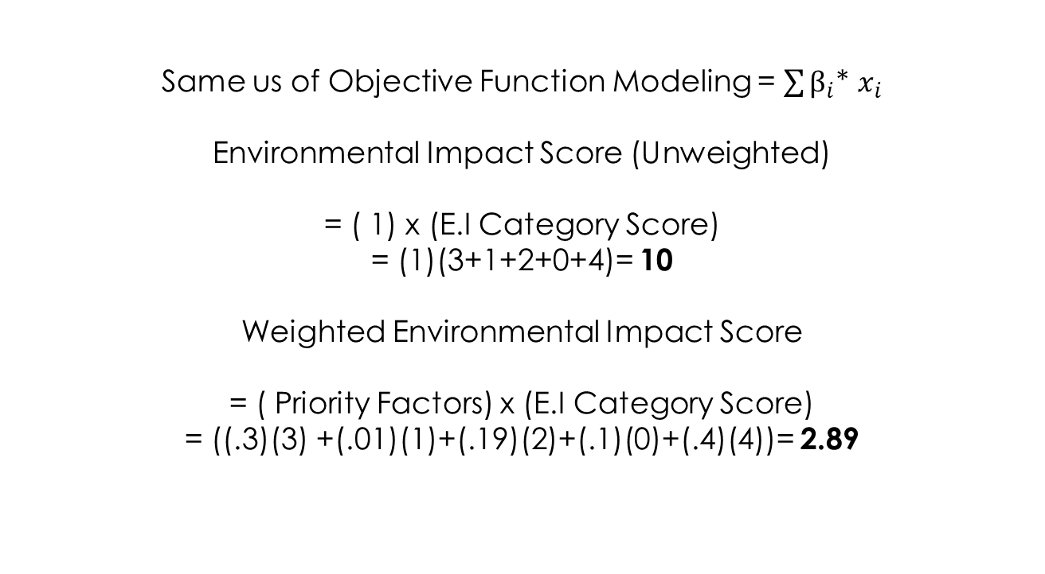
Airfield: Pavement Preservation
Environmental Impact Evaluation: Qualitative
Same us of Objective Function Modeling = $\sum{β_{i}}$* $x_{i}$
Environmental Impact Score (Unweighted)
= ( 1) x (E.I Category Score)
= (1)(3+1+2+0+4)= 10
Weighted Environmental Impact Score
= ( Priority Factors) x (E.I Category Score)
= ((.3)(3) +(.01)(1)+(.19)(2)+(.1)(0)+(.4)(4))= 2.89

Slide 30
Airfield: Pavement Preservation
Environmental Impact Evaluation of Pavement Preservation Practice Alternatives
Future Work
Implement Case Studies with diverse range of airports.
Increase the level of precision to include several units within an impact category with corresponding ranking factors.
Develop more applicable units of environmental impact
Find a way to incorporate Environmental Impact directly into Life-Cycle and Benefit/Cost Analyses.
Encourage Research of Direct Impacts of Pavement Preservation Practices to the Environment

Slide 31
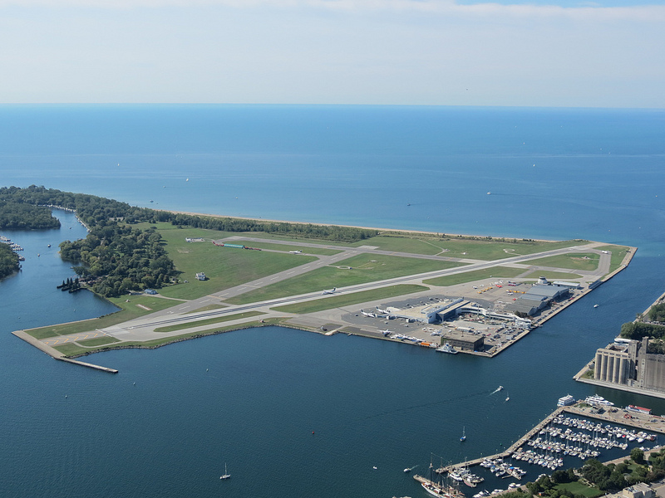
Airfield: Water
http://www.flickr.com/photos/jimbob_malone/8133736313/

Slide 32
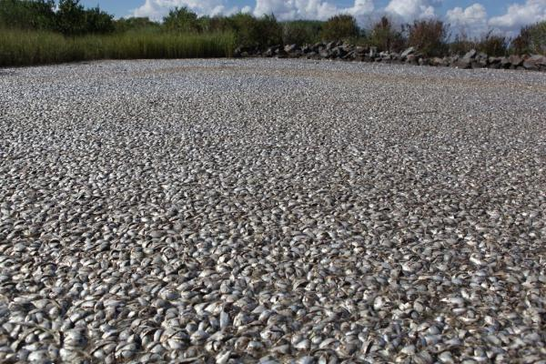
Airfield: Water
Problem: Water contamination
Leakages of fuel, solvents, paints, oil, grease, and detergents are inevitable
Fuel is toxic, and exerts a high biochemical oxygen demand (BOD).
Many detergents contain high levels of phosphates and contribute to eutrophication.
http://allisonkilkenny.com/category/bp/

Slide 33
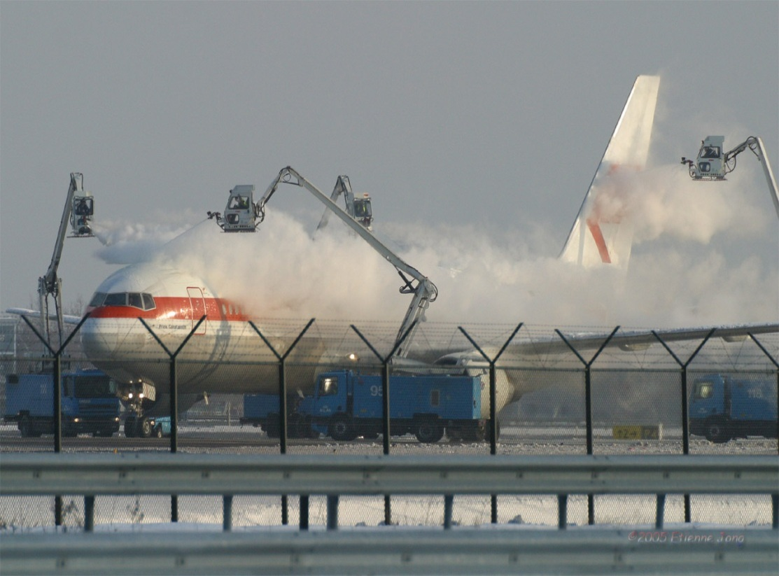
Airfield: Water
Problem: Water contamination
FAA requires the use of
De/anti-icer fluids (ADF)
to ensure public safety.
Many ADF additives
are highly reactive and
produce toxic
byproducts linked to
health problems such as:
-neurological
-cardiovascular
-gastrointestinal
-serious birth defects
-death when ingested in large doses
http://aircraftdeicing.blogspot.com/

Slide 34
Airfield: Water
Solutions
Methods | Quantity | Quality
Centralized Deicing Pads |  | ✓
Vacuum Sweeper Trucks |  | ✓
Open-Water Ponds | ✓ | ✓
Anaerobic Bioremediation |  | ✓
Recovery and Recycling | ✓ | ✓

Slide 35
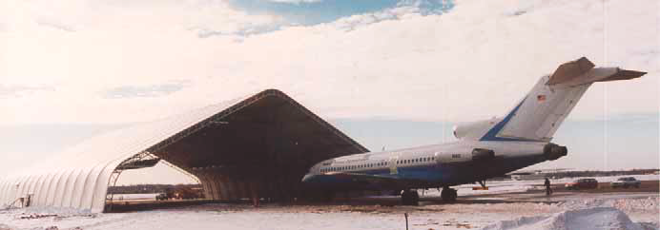
Airfield: Water
Solutions: Centralized Deicing Pads
Centralized Deicing Pad with infra-red deicing (IDF)
http://www.faa.gov/documentlibrary/media/advisory_circular/150-5300-14b/150_5300_14b.pdf
Most effective when located near gate areas of head of runways.
Concentrates ADF to confined area, reducing contamination.
Collected excess ADF may be reused.
Using IDF system reduces amount of ADF needed.
Can be used as fueling station:
  Confines fuel spillage for capture and reuse.
  Provides year usage of plot.

Slide 36
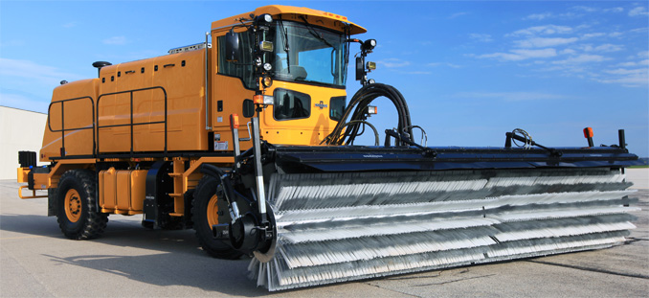
Airfield: Water
Solutions: Vacuum Sweeper Trucks
http://www.oshkoshairport.com/en/SnowTrucks/HSeries/DEMO.aspx
Reduces ADF contamination.
Collected ADF may be reused.
Clears slush and snow, reducing amount of needed ADF.
Fitted with hot stream nozzles, may reduce needed ADF type IV.
May be fitted to control distribution of ADF for anti-icing.

Slide 37
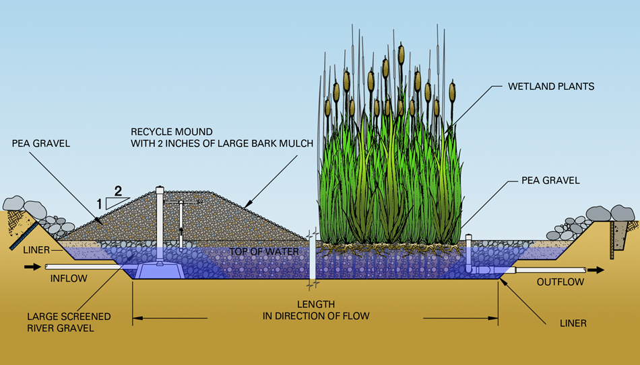
Airfield: Water
Solutions: Open-Water Ponds
(Detention Basin or Constructed Wetlands)
http://adtechenviro.wordpress.com/2010/08/23/imagine-%E2%80%93-an-airport-with-no-wastewater/
Allows ADF to biodegrade before released to natural waters.
Allows solids to settle.
Collects rain/runoff for treatment and reuse.
Provides habitat for wildlife.
Low maintenance.
Reduces bird strike hazard.
May serve as recreational park.

Slide 38
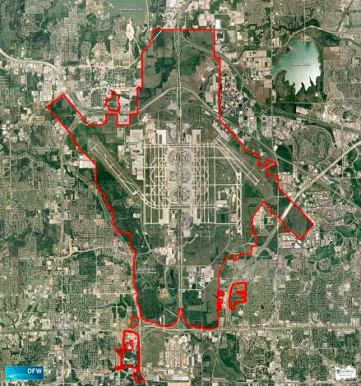
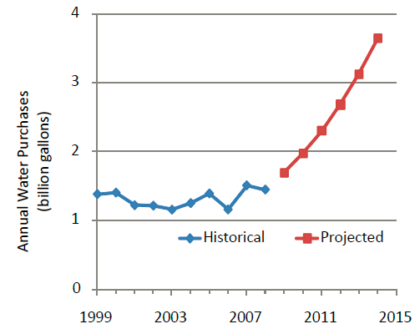
Airfield: Water
Case Study: Detention Basin
Dallas/Fort Worth Airport (DFW)
Trigg Lake
DFW
http://www.govenergy.com/2010/Files/Presentations/Water/Session%209%20Rusty%20Hodapp%202010_GovEnergy_water_reuse.pdf

Slide 39
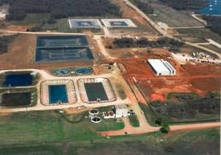
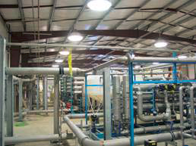
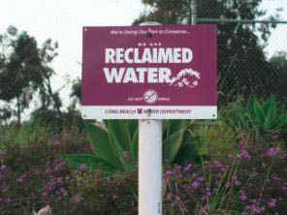
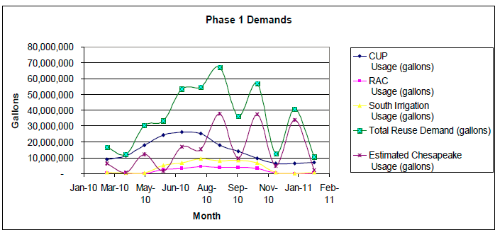
Airfield: Water
Case Study: Detention Basin
Dallas/Fort Worth Airport (DFW)
http://www.govenergy.com/2010/Files/Presentations/Water/Session%209%20Rusty%20Hodapp%202010_GovEnergy_water_reuse.pdf

Slide 40
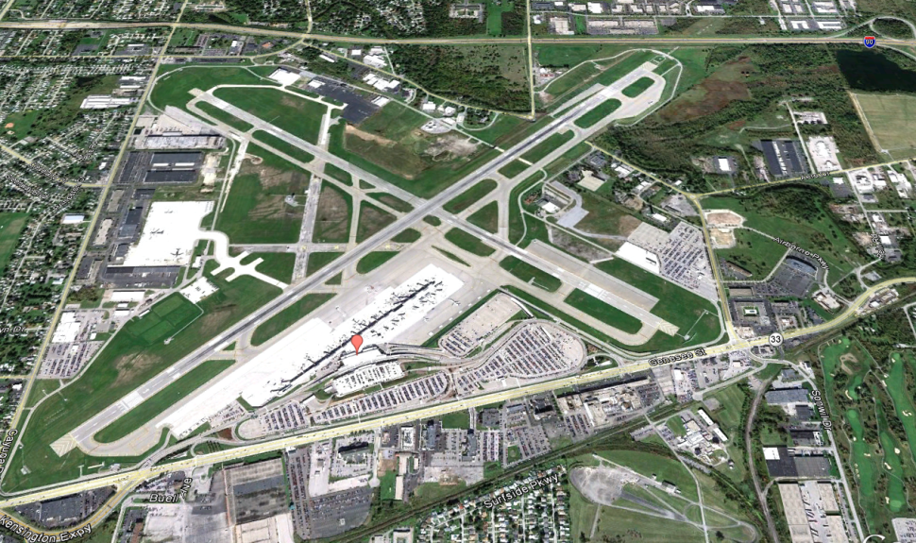
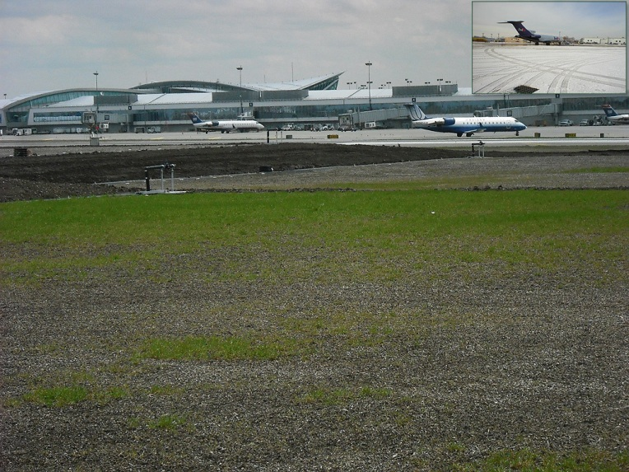
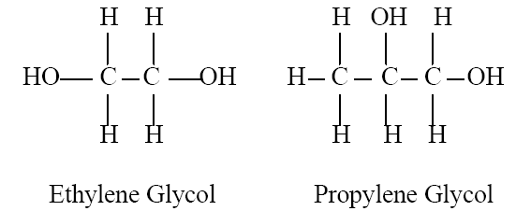

Airfield: Water
Case Study: Constructed Wetland
Buffalo Niagara International Airport (BNIA)
http://www.niagaraforum.org/2012/03/respect-for-competition.html#!/2012/03/
http://www.naturallywallace.com/tech/

Slide 41
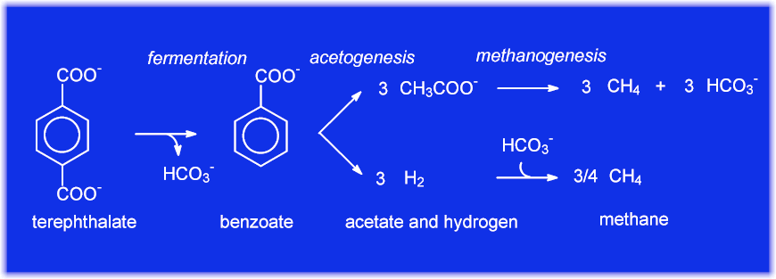
Airfield: Water
Solutions: Anaerobic Bioremediation
http://www.uasb.org/discover/anaerobic_biotechnologies.htm
Can biodegrade larger amounts of ADF in less time.
Reduces oxygen demand levels to permit unrestricted disposal.
Can remove additives from runoff.
Converts glycols in runoff to methane gas, can be used for heating.

Slide 42
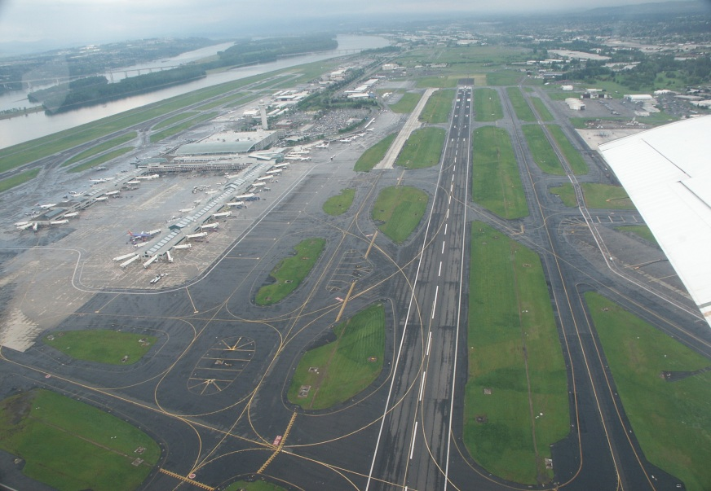
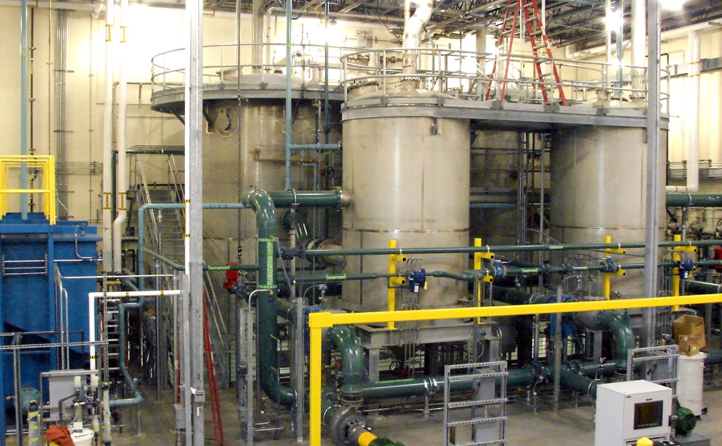
Airfield: Water
Case Study: Anaerobic Bioremediation
Portland International Airport (PDX)
http://www.langleyflyingschool.com/Pages/Ready%20Room.html
http://showcase.greshamsmith.com/Showcase/Projects/Showcase-4/Portland-International-Airport-Deicer-Management

Slide 43
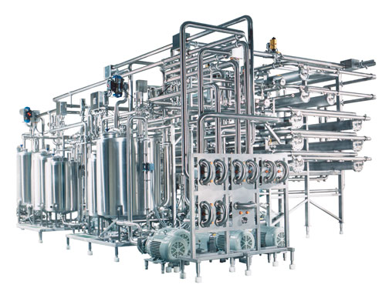
Airfield: Water
Solutions: Recovery and Recycling
http://www.filtrationeng.com/reverse_osmosis.cfm
Filtrate most toxins and contaminants.
Replace potable water with non-potable freshwater for:
- landscape irrigation - toilet flushing
- airfield/aircraft/terminal cleaning
- etcetera
Possibly sell non-potable water to other industries.
Recycle glycol from spent ADF, possibly to sell.

Slide 44
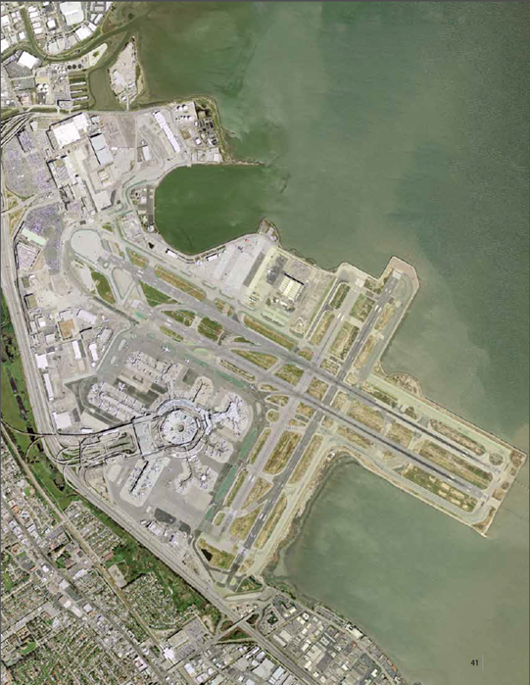
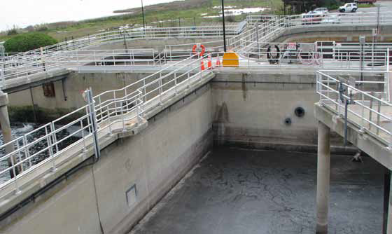
Airfield: Water
Case Study: Recovery and Recycling
San Francisco International Airport (SFO)
Mel Leong Treatment
Plant
http://www.chamoismoon.com/sfo.html
http://www.flysfo.com/downloads/reports/SFO_2011_Environmental_Sustainability_Report.pdf

Slide 45
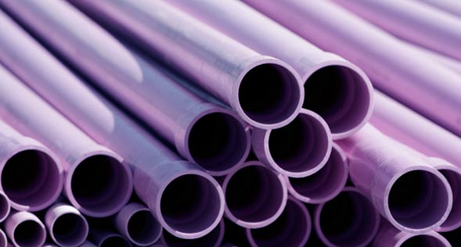
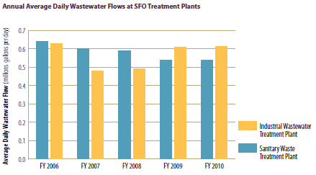
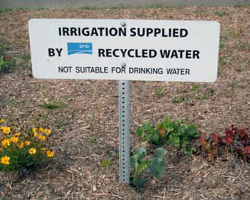
Airfield: Water
Case Study: Recovery and Recycling
San Francisco International Airport (SFO)
Mel Leong Treatment
Plant
http://www.irwd.com/your-water/recycled-water.html
http://www.flysfo.com/downloads/reports/SFO_2011_Environmental_Sustainability_Report.pdf

Slide 46
Sustainable Airport Design & Evaluation
Impact Matrix
Functional Areas | GWP | Virgin Materials | Noise | Air Quality | Water Impact | Wildlife | $
Airfield: Water | ✓ | ✓ |  | ✓ | ✓ | ✓ | ✓

Slide 47



Airfield Lighting Efficiency

Slide 48
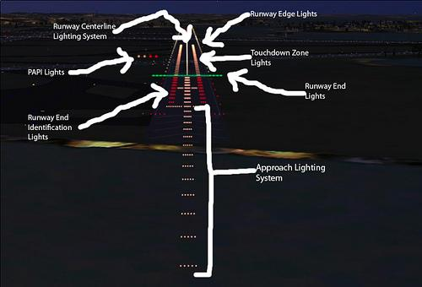
Introduction to Runway Lighting
Notes:
Approach Light Systems
Approach light systems are primarily intended to provide a means to transition from instrument flight to visual flight for landing.

Slide 49
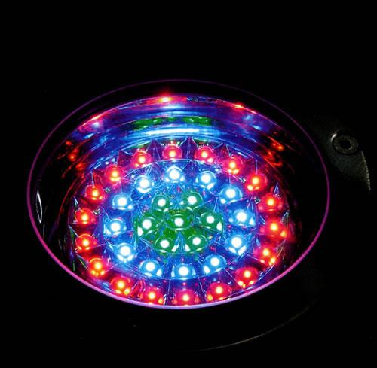
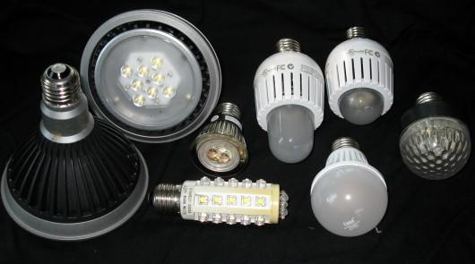
LED Lighting
Light-emitting diode
Aviation lighting
Automotive lighting
Advertising
General lighting
Traffic signals
Notes:
LED stands for light-emitting diode. That is, simply, a semiconductor device that converts electricity to light by using the movement of electrons.
LED lighting is a lamp or other light that uses LEDs as a source of illumination. Most lighting comes from an incandescent or fluorescent light bulb.
They are 300 percent more efficient than a compact fluorescent light (CFL), and 1,000 percent more efficient than an incandescent bulb. They have a very long life, about 50,000 hours of use at 70 percent of their original power.

Slide 50
How long do LED last?
Don't have a filament or igniter
Don't suddenly "burn out"
30,000 to 50,000 hours
Useful life is calculated based upon 70% of its initial light output
Light Source | Typical Rated Light (Hours) | Years (24 hours/day)
Incandescent | 2,500-5,000 | 0.25 - 0.5
Compact Fluorescent | 8,000-15,000 | 1 – 2
White-LED | 25,000-50,000 | 3 - 6
Notes:
LED bulbs last longer because they don’t have the same issues that standard bulbs do. They simply don’t have the parts (filaments, igniters, etc) that other bulbs do that break and cause a bulb to burn out.
Unlike other light sources, LEDs usually don’t suddenly “burn out;” instead, they gradually fade in brightness over time.
LED useful life is generally based on the number of operating hours until the LED is emitting 70%of its initial light output.
Good quality white LEDs in well-designed fixtures are expected to have a rated useful life on the order of 30,000 to 50,000 hours. A typical incandescent lamp lasts about 1,000 hours; a comparable CFL lasts 8,000 to 10,000 hours.

Slide 51
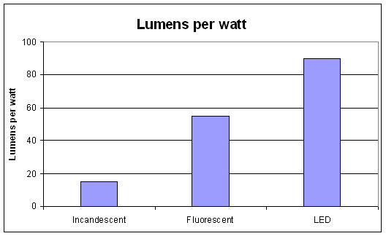
Are LEDs energy-efficient?
LED produce more light per watt than incandescent bulbs
300% more efficient than a compact fluorescent light (CFL),
1,000% more efficient than an incandescent bulb
LED light up very quickly in microseconds
Notes:
The best white LED products meet or exceed the efficiency of fluorescent and high-intensity discharge (HID) light
sources.
They are 300 percent more efficient than a compact fluorescent light (CFL), and 1,000 percent more efficient than an incandescent bulb.

Slide 52
Are LEDs cost-effective?
 | LED | CFL | Incandescent
Light bulb projected lifespan | 50,000 hours | 10,000 hours | 2,000 hours
Watts per bulb (equiv. 60 watts) | 10 | 14 | 60
Cost per bulb | $19.95 | $3.95 | $1.25
KWh of electricity used over | 500 | 700 | 3000
50,000 hours (~6 years assuming 24-hour/day)
Cost of electricity (@ 0.25 per KWh) | $125 | $175 | $750
Bulbs needed for 50k hours of use | 1 | 5 | 42
Equivalent 50k hours bulb expense | $19.95 | $19.75 | $52.50
Total cost for 50k hours | $144.25 | $194.75 | $802.50
Total Saving for 6 years | - | $50.50 | $658.25
Notes:
Costs of LED lighting products vary widely. Good quality LED products currently carry a significant cost premium compared to standard lighting technologies. However, costs are declining rapidly. Recent industry roadmapping indicates prices for warm white LED packages have declined by half, from $36 to $18 per thousand lumens (kilolumens, klm) from 2009 to 2010. Prices are expected to continue to decline significantly to approximately $2/klm by 2015. It is important to compare total lamp replacement, electricity, and maintenance costs over the expected life of the LED product.

Slide 53
Are LEDs green?
 | LEDs | Incandescent
Radiation | RoHS compliant | UV, IR
Toxicant | RoHS compliant | Toxic phosphor powders, Mercury (Hg), Lead (Pb)
CO2 emission | Low | High
Heat Damage | No | High
EMI emissions | No (friendly to electronic equipment) | High (Harmful to electronic equipment)
Recyclable | Yes | No

Slide 54
Influence Matrix
 | Impact Categories
Functional areas | Global Warming | Air Quality | Resources Depletion | Water Quality | Noise
Airfield | X |  | X | X | X
GSE | X | X | X | X
Terminal Facilities | X | X | X

Slide 55
Influence Matrix
 | Impact Catergories
Criteria Clusters | Global Warming | Air Quality | Resources Depletion | Water Quality | Noise
1) Airfield & Terminal Facilities
Reduce number of bulbs |  |  | X
Reduce the release of toxicants | X | X |  | X
Reduce Energy Usage |  |  | X
Notes:
Reduce number of Light bulbs = reduce resource depletion
LEDs produce less of – Hg, CO2, EMI, heat, etc
LEDs require less electricity
LEDs last longer so its also influence the resource category
LEDs are recyclable

Slide 56
Methodology
Objective | Impact | Indicators | Index | Criteria | Unit
Reduce Number of Bulbs | RD | Useful Life | Q | Quant. | hours
 | RD | Amount of lumen produced | Q | Quant. | lm/W
Reduce the release of toxicants | GW | Total CO2 emission | P | Quant. | kg/year
 | AQ | Total Hg, CO2, NO, SO2 emission | P | Quant. | g/year
Reduce Energy Usage | RD | Amount of Watt Required | Q | Quant. | Kw/h
RD = Resources Depletion
GW = Global Warming
AQ = Air Quality
Notes:
100 watt incandescent filament bulb which is lit for an average of 4 hours every day. During the generation of the electricity for this one bulb then a massive 100kg of CO2 will be produced every year.
About 50 percent of the electricity produced in the U.S. is generated by coal-fired power plants. When coal burns to produce electricity, mercury naturally contained in the coal releases into the air
Approximately 0.0234 mg of mercury—plus carbon dioxide, sulfur dioxide and nitrogen oxide—releases into the air per 1 kwh of electricity that a coal-fired power plant generates.
Over the 7500-hour average range of one CFL, then, a plant will emit 13.16 mg of mercury to sustain a 75-watt incandescent bulb, 3.51 mg of mercury to sustain a 20-watt CFL (the lightning equivalent of a 75-watt traditional bulb)

Slide 57
To be continue....
SFO Case Study
Indicator evaluations
Replacement of LEDs for:
Parking garages
Terminal Buildings
Offices
Restaurants

Slide 58
References
http://lindsays5624.hubpages.com/hub/How-much-CO2-does-a-light-bulb-use
http://apps1.eere.energy.gov/buildings/publications/pdfs/ssl/energy_efficiency_white_leds.pdf
http://apps1.eere.energy.gov/buildings/publications/pdfs/ssl/led_basics.pdf
http://emerald.ts.odu.edu/Apps/FAAUDCA.nsf/SunEnvironmentEvaluationofAirfield2nd.pdf?OpenFileResource
http://www.faa.gov/regulations_policies/advisory_circulars/index.cfm/go/document.list/parentTopicID/63
http://www.genesislamp.com/11a21rulibua.html
http://www.lrc.rpi.edu/resources/newsroom/pdf/2007/BlueTaxiway8511.pdf
http://www.popularmechanics.com/home/reviews/news/4217864
http://www.vividleds.us/pages/airport-led-lighting.html#.ULqz2oNX3Io
Notes:
http://www.vividleds.us/pages/airport-led-lighting.html#.ULqz2oNX3Io
http://apps1.eere.energy.gov/buildings/publications/pdfs/ssl/energy_efficiency_white_leds.pdf
http://apps1.eere.energy.gov/buildings/publications/pdfs/ssl/led_basics.pdf
http://www.lrc.rpi.edu/resources/newsroom/pdf/2007/BlueTaxiway8511.pdf
http://www.genesislamp.com/11a21rulibua.html
http://www.faa.gov/regulations_policies/advisory_circulars/index.cfm/go/document.list/parentTopicID/63
http://emerald.ts.odu.edu/Apps/FAAUDCA.nsf/SunEnvironmentEvaluationofAirfield2nd.pdf?OpenFileResource

Slide 59
Sustainable Airport Design & Evaluation
Impact Matrix
Functional Areas | GWP | Virgin Materials | Noise | Air Quality | Water Impact | Wildlife | $
Airfield | ✓ | ✓ | ✓ | ✓ | ✓ | ✓ | ✓
Ground Support Equipment | ✓ | ✓ |  | ✓ | ✓ |  | ✓
Terminal Facilities | ✓ | ✓ | ✓ | ✓ |  | ✓ | ✓

Slide 60
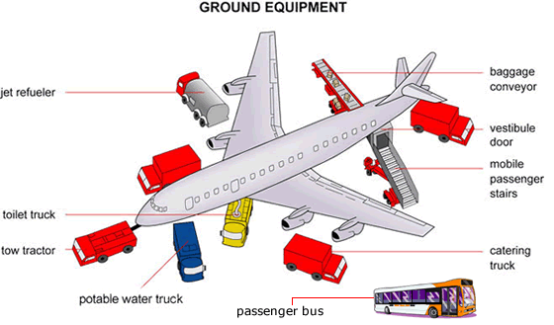
Introduction to GSE
Ground Support Equipment – are the vehicles that service an aircraft in between flights

Slide 61
Overview of presentation
Project Scope
Methodology
Suggestions

Slide 62
Project Scope
analyze the environmental impacts of GSEs from a life-cycle perspective
develop a decision support tool to aid future policies on GSEs

Slide 63
Project Scope – what is life cycle?
Life Cycle:
  Production
  O&M (GSE usage and fuel storage)
  EOL (recycle or dispose)

Slide 64
Project Scope – why life cycle?
There is no boundary for pollutants
  1984, Bhopal, India, toxic cloud from nearby pesticide plant drifted over the city and killed 20,000 to date
Forces airport truly to think “community” and be more environmentally responsible

Slide 65
Overview of presentation
Project Scope
Methodology
Suggestions

Slide 66
Methodology – decision support tool
Impact
Criteria
Indicator
Cost
decision

Slide 67
Methodology – Impact Categories
Impact Categories | Global Warming (GW) | Air Quality (AQ) | Resource Depletion (RD) | Water Quality (WQ)
GSE | x | x | x | x

Slide 68
Methodology – decision support tool
Impact
Criteria
Indicator
Cost
decision

Slide 69
Methodology – Criteria
Criteria Clusters | GW | AQ | RD | WQ
GSE tailpipe emissions | x | x |  | x
GSE life cycle emissions | x | x | x
Fuel life cycle emissions | x | x |  | x
Fuel’s resource use |  |  | x

Slide 70
Methodology – decision support tool
Impact
Criteria
Indicator
Cost
decision

Slide 71
Methodology – Indicator
GW : g CO2 eq
AQ : g CO, PM, SO2, NOx, HC
RD : land, crude oil, NG, coal
WQ : g fuel

Slide 72
Methodology – Indicator

Slide 73
Methodology – Indicator

Slide 74
Methodology – Indicator

Slide 75
Methodology – Indicator

Slide 76
Methodology – decision support tool
Impact
Criteria
Indicator
Cost
decision

Slide 77
Methodology – Cost
Life cycle analysis in 4 areas:
  GSE
  GSE storage facility
  Fuel
  Fuel storage facility

Slide 78
Methodology – Cost
Alternative fuel programs
  FAA programs (i.e. VALE)
  Governmental regulations (i.e. ARB, Carl Moyer Program)

Slide 79
Methodology – decision support tool
Impact
Criteria
Indicator
Cost
decision

Slide 80
Methodology – decision process
Reduction goal
Choose alternatives
Collect data
Generate result
Decision

Slide 81
Decision process – reduction goal
Choose the indicators for reduction
emphasis on indicators vary geographically
  In Europe, maybe GW is the most important
  In Beijing, maybe AQ is the most important
  In other areas, maybe RD is the most important

Slide 82
Decision process – reduction goal
Different programs have different trade-off standard
  Carl Moyer Program: $12,000/ton NOx
  EPA study in 1999: $10,000~$20,000/ton PM

Slide 83
Decision process – choose alternatives
Case study:
  Baggage tugs
    Target indicator: NOx
    Alternatives: diesel (current), electric (proposed)

Slide 84
Decision process – collect data
Current programs’ calculations
What they are missing
Our calculations

Slide 85
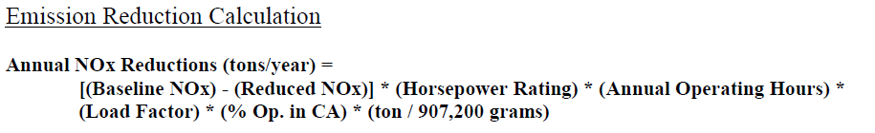
Decision process – collect data
Sample calculation from Carl Moyer Program

Slide 86
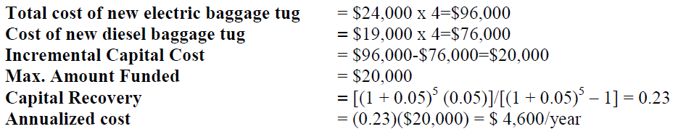
Decision process – collect data
Sample calculation from Carl Moyer Program

Slide 87
Methodology – diesel vs. electric
$3,150/ton NOx

Slide 88
Decision process – collect data
(100hp)(4 baggage tugs)(876hr/yr)(0.55)(0.75kW/hp)*
(0.00025lbs/kwh)(0.0005ton/lbs) = 0.02tons/yr
Nox emission factor in California, based on US Clean Energy Midwest Clean Energy Application center

Slide 89
Methodology – Collect Data
Electric baggage tug: $22,080
Cost of electricity: $19,000
Cost of new facility: --
Total cost of electric GSE: $31,000
Diesel baggage tug: $17,480
Cost of diesel: $50,000
Cost of fuel storage tanks: --
Total cost of diesel GSE: $67,000

Slide 90
Methodology – diesel vs. electric
$-25,000/ton NOx

Slide 91
Overview of presentation
Project Scope
Methodology
Suggestions

Slide 92
Suggestion – electric
Pros:
  Very effective emission reduction
  Many of electric powered GSE are already available in the marketplace.
Cons:
  Increase in offsite emissions for power generating plant
  May not be able to store sufficient battery capacity to provide the required service demands given space limitations
  Require scheduling for use of quick recharging facility

Slide 93
Suggestion – fixed gate
Pros:
  Eliminate significant fraction of GSE (less fuel, storage, maintenance, and operation planning cost)
  Eliminate recharging infrastructure through “hard-wired” electrical power connections
  Higher HC and CO emission reduction
Cons:
  Higher initial cost (increase in offsite power generating station)
  Not all services can be replaced by it (i.e passenger and service personnel transport, cargo and baggage transport)
  Expensive and difficult to retrofit alongside current design

Slide 94

Challenges of this project
Insufficient research and data collection on this subject area (i.e. calculations)
Our calculation is missing:
  Environmental analysis of production and EOL of vehicle

Slide 95

Challenges of this project
GSE is controlled by the airlines and they have different agenda than the airport itself.
Sustainable!
No money!

Slide 96
GSEs in LAWA in 2008
100% of LA/ONT tenant GSEs are electrically powered
~24% of LAX’s tenant GSEs are zero-emission vehicles
~17% of LAX’s tenant GSEs use CNG or LNG

Slide 97
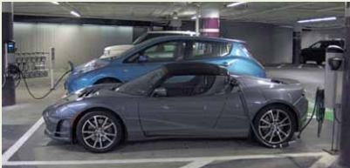
GSEs in SFO in 2011
300+ GSEs are electrically powered
All gates at Terminal 2 are equipped with electricity charging stations
All gates are equipped with fuel hydrants, replacing fuel trucks

Slide 98
Solar Power Panels
By
Lenard Tran

Slide 99
Why solar power?
Green renewable energy
Reduce long term energy cost
Little maintenance in its life cycle

Slide 101
PV vs. CSP
PV – Solar Photovoltaic
  Absorb sunlight
  Small surface area
  Readily installed
CSP - Concentrated Solar Power
  Large surface area
  Can store energy to be used later
  Potential glaring

Slide 102
Case Studies
Metropolitan Oakland International Airport – California
  Glaring and Radar Interference
SFO and Fresno Yosemite International (FYI) Airport
  Unused lands
Denver International Airport
  Tracking system vs. Non-tracking system
Georgia Institute of Technology
  Cost effective

Slide 103
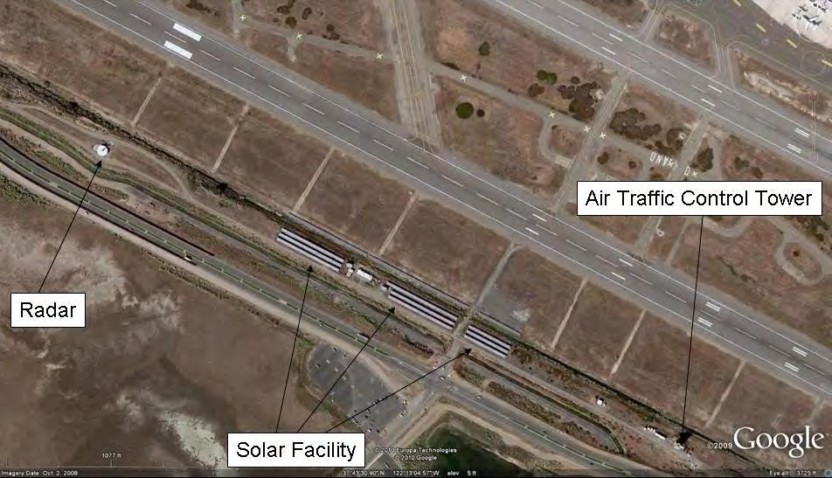
Glaring – Radar Interference
    PV
    Dark, light absorb materials
    Anti-reflective coating
    Install the panels 400 feet from the runway.
    FAA require 500 ft buffer from the radar tower.
    Since 2007, no incidents were reported

Slide 104
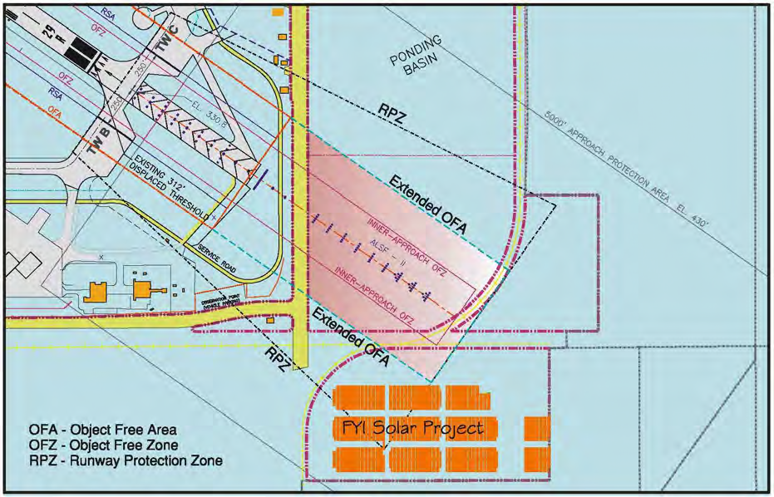
  San Francisco Airport
  Terminal 3
Land Used
Fresno Yosemite
International Airport

Slide 105

Tracking vs. Non-tracking systems
Denver International Airport
  Energy produce
  Cost of Maintenance

Slide 106
Cost Effective
Unpredictability price of conventional electricity
  Increase 38% in 15 years
Solar Power
  High construction cost
  Low future cost
    0.2% of total cost
    Price will decrease 4% per years.

Slide 107
Displacement Ventilation System
Connie Lau

Slide 108

Displacement Ventilation System
Innovative strategy of air distribution
Outdoor air supplied to building at ground level

Slide 109


Displacement Ventilation System: SFO Terminal 2
Notes:
A displaced ventilation system was incorporated into the design of SFO’s terminal 2. It was very suitable for terminal 2 because the terminal has high ceilings and there is no need to air condition the entire upper level which is an unoccupied zone.

Slide 110

Displacement Ventilation System: Influence Matrix
 | Impact Categories
Functional Area | Thermal Comfort | Acoustical Comfort | Improved Air Quality | Energy Efficiency | CO2 Reduction | Lower Overall Life Cycle Cost
Terminal Building
Notes:
The impact categories of a DVS includes:
Thermal Comfort Acoustical Comfort Improved Air Quality
Energy Efficiency CO2 Reduction Lower Life Cycle Cost

Slide 111
Displacement Ventilation System: Thermal & Acoustical Comfort
Small zones of thermal comfort
Wide temperature gradient in occupied zone
Quiet ambience due to:
  Lower velocities

Slide 112
Displacement Ventilation System: Improved Air Quality
High ventilation effectiveness
Contaminants are exhausted to the outdoors
Improved filtration

Slide 113
Displacement Ventilation System: Energy Efficiency
Increased use of economizers
Less energy consumption due to reduced peak cooling load

Slide 114

Displacement Ventilation System: SFO Terminal 2 – Energy and CO2 Reduction
Notes:
When compared to traditional overhead mixing systems, it was determined that the displacement system at the SFO terminal 2 would reduce energy consumption by 20% and CO2 emissions by an estimated 1,667 tonnes annually.

Slide 115
Displacement Ventilation System: Lower Overall Life Cycle Cost
MIT Study of HVAC systems:
  720,000-square-foot building
  Cost saving ≥ 1/2 million dollars over a 20-year life
Notes:
According to an MIT study on HVAC systems:
For a 720,000-square-foot building, a displaced ventilation system can have an overall cost saving of at least half million dollars over a 20-year life cycle.

Slide 116
Displacement Ventilation System: SFO Terminal 2
 | Impact Categories
Functional Area | Thermal Comfort | Acoustical Comfort | Improved Air Quality | Energy Efficiency | CO2 Reduction | Lower Overall Life Cycle Cost
Terminal Building
Notes:
SFO did excellent in sustainability according to our framework.
Satisfying our 6 impact categories of:
Thermal Comfort Acoustical Comfort Improved Air Quality
Energy Efficiency CO2 Reduction Lower Life Cycle Cost

Slide 117


SFO Terminal 2
The first LEED Gold-certified airport terminal in the U.S.
Notes:
Helping SFO’s Terminal 2 to reduce the overall environmental footprint and becoming the first LEED Gold-certified airport terminal in the U.S.

Slide 118
References
http://tateinc.com/pdf/mit_cost_study.pdf
http://www.energydesignresources.com/media/1723/EDR_DesignBriefs_displacementventilation.pdf?tracked=true

Slide 119
Green Roof in SFO Airport
By
Elmira Manafiafkham

Slide 120


O'Hare International Airport

Slide 121
Types of Green Roof
Substrate based roof
Sedum mats
  Recommended for SFO
  Sedum plantation
Green/Brown roofs for biodiversity

Slide 122
Advantages of Green Roof
Thermal Insulation
  Capture rain water – increase humidity – fresher air
Noise Insulation
  Plant absorbs sound waves
Air Quality and Reduction in Carbon Dioxide

Slide 123


Slide 124
Disadvantage of Green Roof in SFO:
WILDLIFE ATTRACTION
  Landfills
  Bay Area
    Seagulls
    Mallard Ducks
  Potential collision with airplane
    Hudson River incident

Slide 125
Solutions
Not open to public
  People feed the birds
  Large amount of trash
Seagull attracted to aggregate
Mallard ducks are attracted to aquatic vegetation
  Sedum plantation

Slide 126

Questions?

