Slide 1
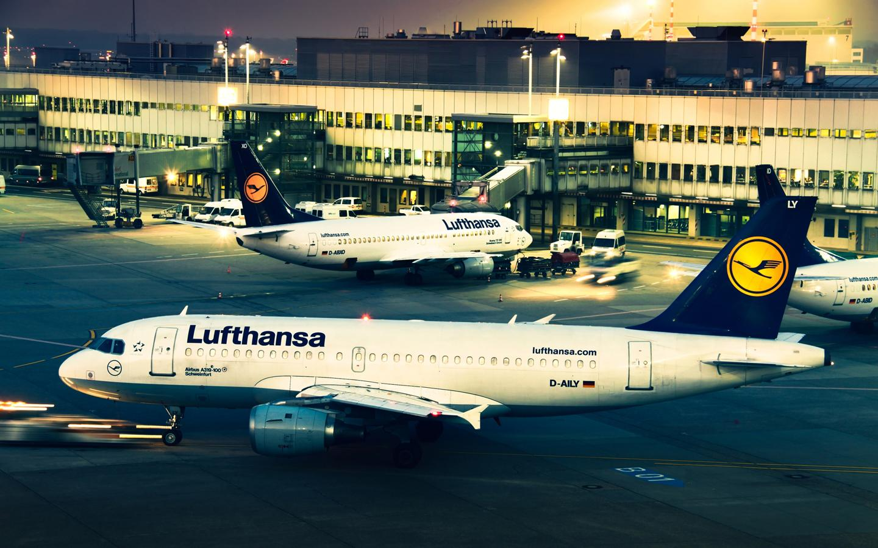
Collaborative Gate Allocation
Alex Cuevas, Joanna Ji, Mattan Mansoor,
Katie McLaughlin, Joshua Sachse, and Amir Shushtarian

Slide 2
Agenda
Introduction
The Need for Collaboration
Possible Scenarios
Economics and Feasibility
Simulation Model
Recommendation & Next Steps

Slide 3
What is CGA?
Collaborative Gate Allocation is a dynamic model of a new, more efficient policy to help reach the system optimum of gate use and allocation.
Requires data sharing and collaboration from
Airlines
Airport operators
FAA
Communities

Slide 4
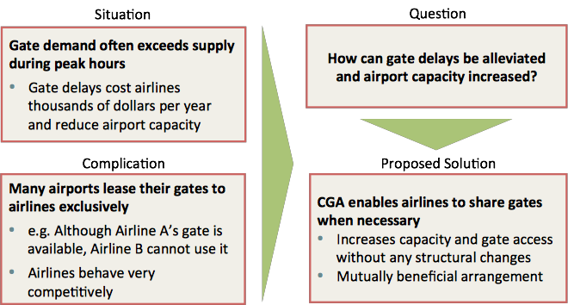
The Need for CGA

Slide 5
Analysis of Major Players
Major Player | Primary Interests | Preferred Method of Collaboration | Main Opportunity Presented by CGA
Airports | - Maximize Revenue - Run efficiently | - Full or partial collaboration | - Increased utilization of gates without infrastructure investments
Airlines | - Maximize control of gates - Keep other airlines from obtaining gates -Minimize delays | - Alliances or minimal collaboration (overflow only) | - Reduced delays and fuel burn savings - Increased collaboration among airlines
FAA | - Safety - Efficiency | - Full or partial collaboration | - Reduced congestion of ramp areas and thus fewer accidents
Communities | - Minimize pollution - Minimize noise | - Full collaboration | - Less carbon emissions and pollution from fewer gate delays
Once we convince airlines (through financial and environmental arguments) that gate sharing is mutually beneficial, airlines should be more receptive to change and more willing to collaborate

Slide 6
Scenario 1: Airports control shared gates
Airport keeps portion of the gates, and allocates them to airlines facing gate constraints during their peak hours.
Advantages:
Airlines keep the control of majority of the gates
Decreases gate leasing costs for airlines
Does not require airline cooperation!
Disadvantages:
Airport must get involved in gate allocation process
Encourages over-scheduling to gain more shared gate slots
Many gates are under long-term leases

Slide 7
Scenario 2:
Airlines share gates
Airlines cooperate with each other and rent extra gates to airlines in need.
Advantages:
Does not require Airports to get involved
Airlines benefit from less delays due to shortage of gates and income from renting extra gates
Requires minimal modifications to leasing agreements
Disadvantages:
Shared gates must be standardized to serve all airlines
Airlines may not cooperate equally with each other
Decreases the efficiency of ground crew

Slide 8
Scenario 3:
Airlines pool gates
Hybrid of both previous methods. Airlines create pool of gates that they are willing to share with other airlines.
Advantages:
Does not require Airport to get involved in the process
Decreases gate leasing costs for airlines
Fewer gates to standardize
Requires minimal changes to previous lease agreements
Increases service efficiency compared to other methods
Disadvantages
Larger airlines may not participate
Encourages over-scheduling to gain more shared gate slots

Slide 9
Economics of CGA
New terminals: 40% of capital investments
Average cost of a delayed flights exceeds profit from flight.
Estimated 3-5% increase in capacity, allowing for increased density of scheduling and throughput.

Slide 10
Economic Deterrents
Reduces oligopolistic advantage of larger airlines
Requires implementation and interfacing with individual airline allocation systems
Requires increased mobility of ground operations

Slide 11
Economics Incentives
Reduced delays
Lowers costs to passengers and airlines
Increased Predictability
Leads to increased Capacity through tighter scheduling
Minimal capital investment and land requirements
Increases competitiveness of smaller airlines

Slide 12
Gate Allocation (GA) Model
Need quantitative results!
Computer model to simulate GA scenarios
Cost and benefit analysis based
on airport-specific parameters
Present findings to airport and
airlines for negotiations

Slide 13
Gate Allocation (GA) Model
CGA group
FAA
Airlines

Slide 14
Gate Allocation (GA) Model
GA model in Java
Object oriented approach
Data parser
Gate assignment is NP-Hard
Large inputs can't be solved
Use greedy algorithm + heuristics
Adjustable precision based on CPU
Formatted output data

Slide 15
Gate Allocation (GA) Model
Takes flight schedules as input
Flight schedule = list of flights
Flight (aircraft type, alliance affiliation, arrival t, departure t)
Takes parameters (e.g. desired buffer times, # of shared gates)
Applies random delays and recalculates approximation of optimal gate mapping

Slide 16
GA Flowchart
Parameters
+
Scenario
Flight Schedule
Gate Mapping
Gate
Allocation
Algorithm
Flight Schedule
Gate Mapping
Delay

Slide 17
Gate Allocation (GA) Model
Methodology:
Choose target airport
Determine set of scenarios
Allocation algorithm
Alliance configuration
Collaborative gate configuration
Run GA algorithm
Run CBA on results
Compile and present

Slide 18
Results!
Work in Progress

Slide 19
Other Potential Scenarios
Complete Collaboration
All airlines are required to participate
Partial Collaboration
Airlines can opt in if they see a benefit
Alliance Collaboration
Global Alliances can work together
Airport-Specific Alliances of all small players against one large player can be formed

Slide 20
Recommendation & Next Steps
- CGA will function only if all players are willing to collaborate.
- Continue developing model for a more well-rounded recommendation

